Slide 1
C++ for Advanced Mathematical Finance lecture 4
Simon Hartley

Slide 2
Introduction – SYLLABUS
Programming in C++
Monte Carlo Methods
Dice rolls
Pi
Share price

Slide 3
C++ – Monte Carlo Methods
The terms Monte Carlo Methods, Monte Carlo Simulations or Monte Carlo Experiments are broadly used terms to describe techniques/methods/algorithms using random sampling for numerical approximations. They are widely used to simulate stochastic processes in many areas, e.g.
Diffusion Equations(Brownian motion)
Stock market movements

Slide 4
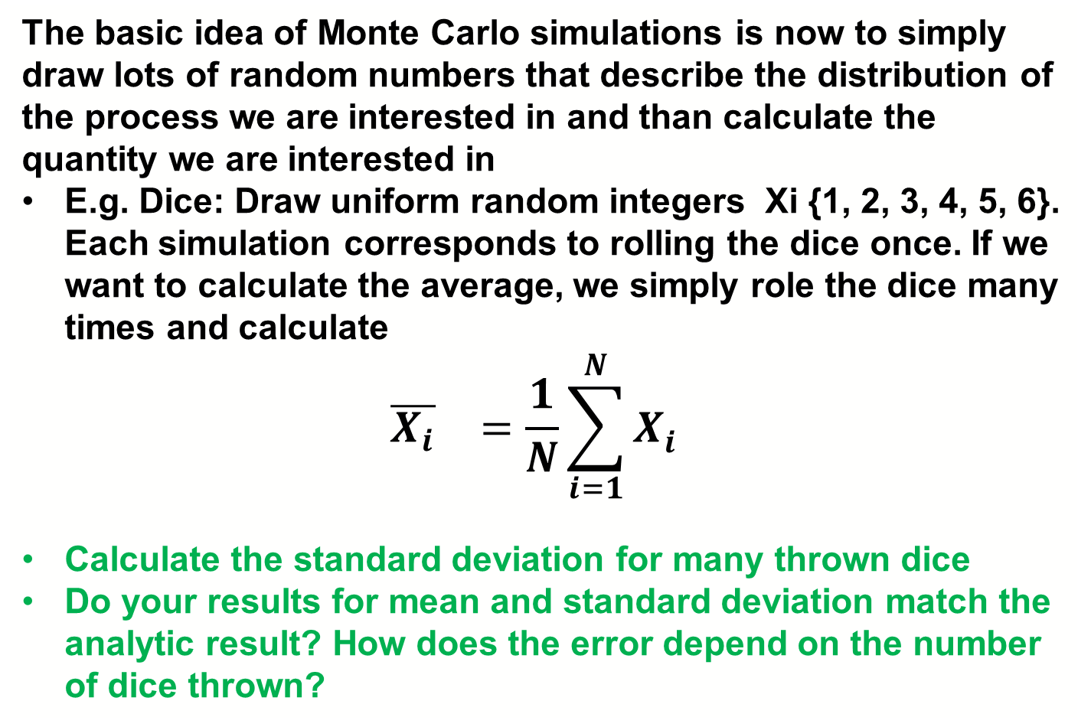
C++ – Monte Carlo Methods
The basic idea of Monte Carlo simulations is now to simply draw lots of random numbers that describe the distribution of the process we are interested in and than calculate the quantity we are interested in
E.g. Dice: Draw uniform random integers Xi {1, 2, 3, 4, 5, 6}. Each simulation corresponds to rolling the dice once. If we want to calculate the average, we simply role the dice many times and calculate
$${\overline{X_{i}}}_{}=\frac{1}{N}\sum_{i=1}^{N}{X_{i}^{}}$$
Calculate the standard deviation for many thrown dice
Do your results for mean and standard deviation match the analytic result? How does the error depend on the number of dice thrown?

Slide 5
C++ – Monte Carlo Methods
random_device random_dev;
mt19937 random_generator(random_dev());
// Create a uniform distribution for integers between 1 and 6
uniform_int_distribution <int> distribution(1, 6);
constexpr int N = 1000000; //number of repeats of dice thrown
double mean{0.0};
double std{0.0};
for (int i = 0; i < N; ++i){
double rnd = (double)distribution(random_generator);
// calculate the mean by adding up repeatedly thrown dice
mean += rnd / N;
// To calculate the standard deviation, we first calculate the second moment
std += rnd*rnd / (N - 1.0);
}
// After loop is over we subtract the square of the mean and take the square root
std -=( mean*mean*N)/(N - 1.0);
std = sqrt(std);

Slide 6
C++ – Monte Carlo Methods Pi
Imagine we would not know the value of Pi
Use A Monte Carlo Simulation to calculate the area of a disk
Estimate Pi
The Algorithm 1. Initialize circle_points, square_points and interval to 0. 2. Generate random point x. 3. Generate random point y. 4. Calculate d = x*x + y*y. 5. If d <= 1, increment circle_points. 6. Increment square_points. 7. Increment interval. 8. If increment < NO_OF_ITERATIONS, repeat from 2. 9. Calculate pi = 4*(circle_points/square_points). 10. Terminate.

Slide 7
C++ – Monte Carlo Methods Pi
// Create a uniform distribution for integers between 0 and 1
uniform_real_distribution <double> distribution(0, 1);
constexpr long long N = LLONG_MAX/10000000; // number Runs/repeats
cout << "N=" << N << std::endl;
// 1. Initialize circle_points, square_points and
double rand_x{0.0}, rand_y{0.0}, origin_dist{0.0}, pi{0.0};
long long circle_points = 0, square_points = 0;
for ( ; square_points < N; ++square_points){
// 2. Generate random point x.
rand_x = (double)distribution(random_generator);
// 3. Generate random point y.
rand_y = (double)distribution(random_generator);
// 4. Calcúlate d = x*x + y*y.
origin_dist = (rand_x * rand_x) + (rand_y * rand_y);
// 5. If d <= 1, increment circle_points.
circle_points += (origin_dist >= 1.0) ? 0 : 1;
// 6. Increment square_points. (in for() expression
// 7. Increment interval.( ++square_points)
// 8. If increment < NO_OF_ITERATIONS, repeat from 2. // square_points < N
}
// 9. Calculate pi = 4*(circle_points/square_points).
pi = (4.0 * circle_points / square_points);
cout << "estimated PI: " << std::setprecision(9) << pi << endl;
// 10. Terminate.

Slide 8
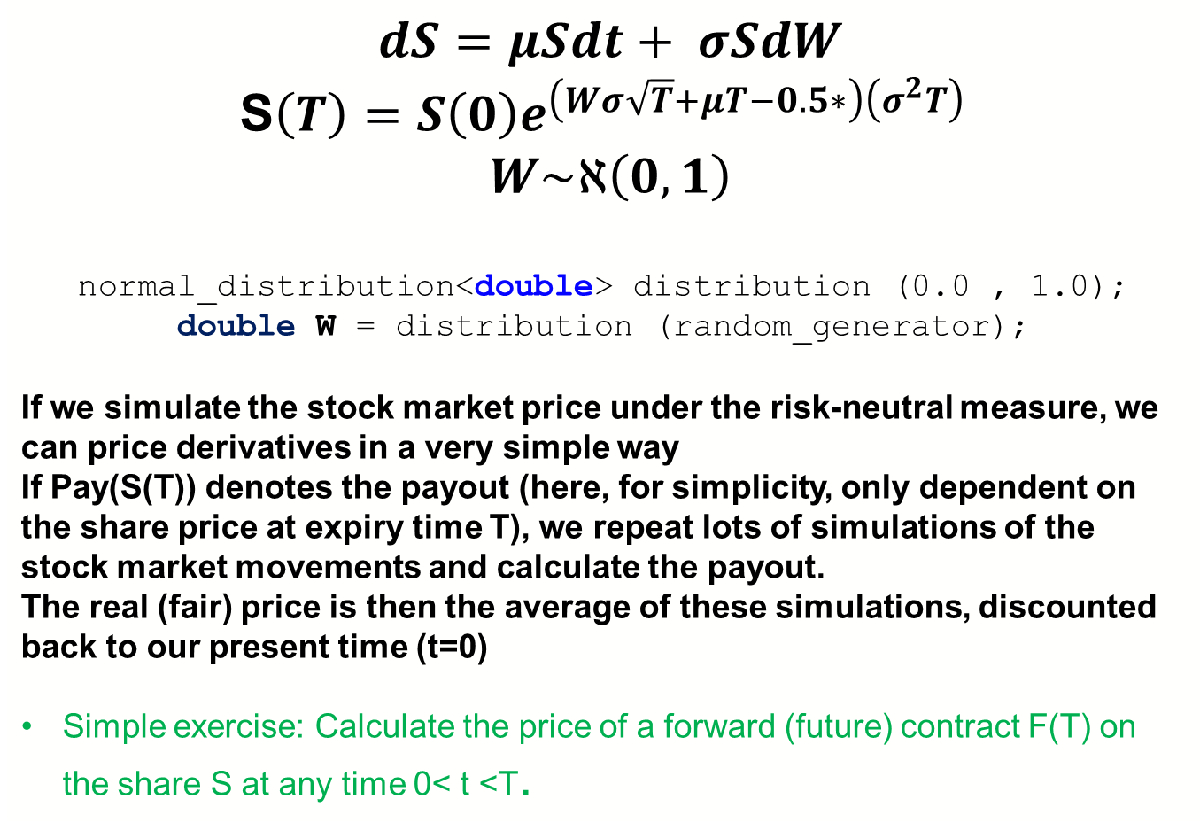
C++ – Monte Carlo Methods
$dS=μSdt+ σSdW$
S$\left(T\right)=S\left(0\right)e^{\left(Wσ\sqrt{T}+μT−0.5∗\right)\left(σ^{2}T\right)}$
$W\sim ℵ\left(0,1\right)$
normal_distribution<double> distribution (0.0 , 1.0);
double W = distribution (random_generator);
If we simulate the stock market price under the risk-neutral measure, we can price derivatives in a very simple way
If Pay(S(T)) denotes the payout (here, for simplicity, only dependent on the share price at expiry time T), we repeat lots of simulations of the stock market movements and calculate the payout.
The real (fair) price is then the average of these simulations, discounted back to our present time (t=0)
Simple exercise: Calculate the price of a forward (future) contract F(T) on the share S at any time 0< t <T.

Slide 9
C++ – Monte Carlo Methods
They can also be employed to solve deterministic problems
Monte Carlo integration
Option pricing
As mentioned:
AMF4_PartA_Slides21

Slide 10
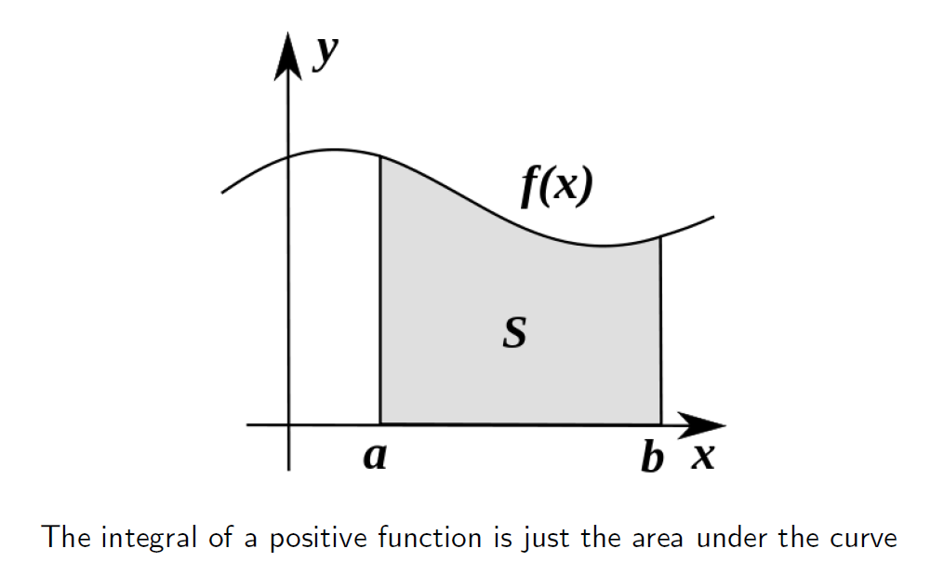
C++ – Monte Carlo Integration
We have used fact that different simulations are independent.

Slide 11
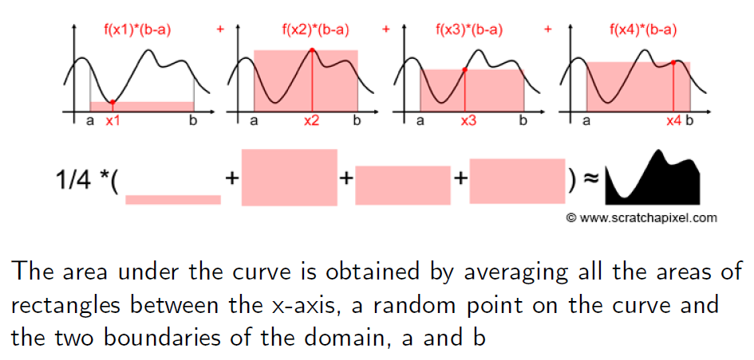
C++ – Monte Carlo Integration
We have used fact that different simulations are independent.

Slide 12
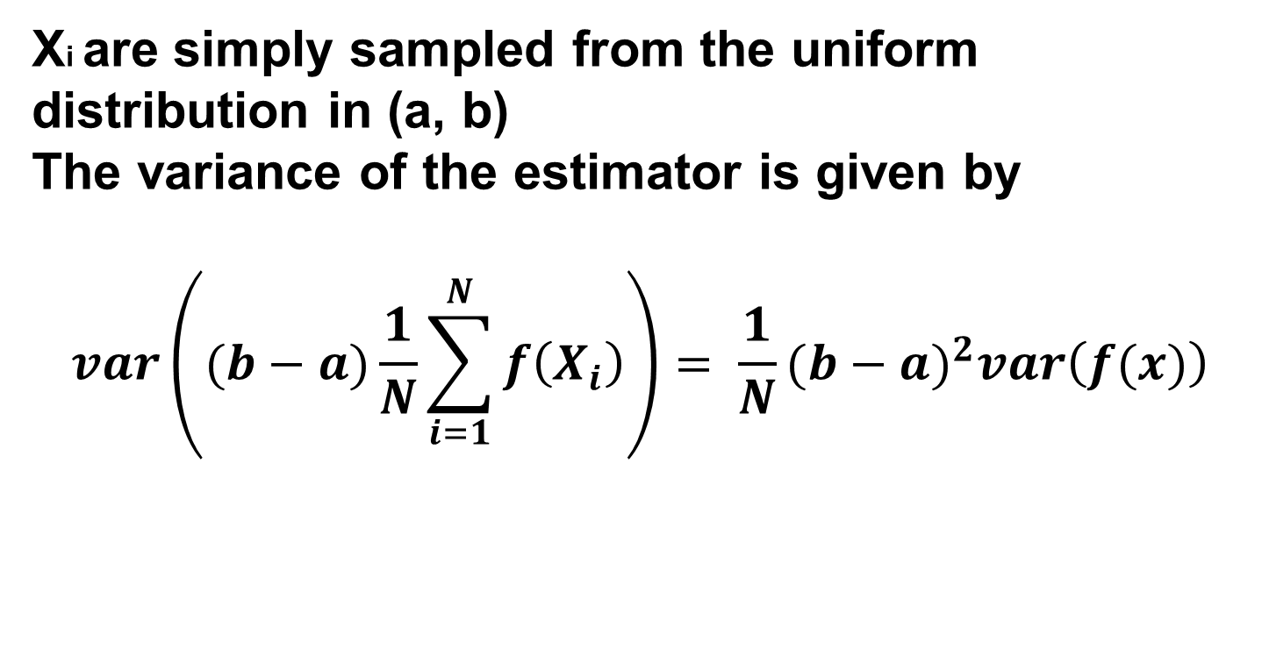
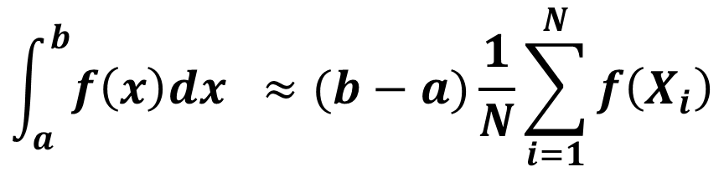
C++ – Monte Carlo Integration
$$\int_{a}^{b}{f\left(x\right)dx }≈(b−a)\frac{1}{N}\sum_{i=1}^{N}{f\left(X_{i}\right)}$$
Xi are simply sampled from the uniform distribution in (a, b)
The variance of the estimator is given by
$$var\left((b−a)\frac{1}{N}\sum_{i=1}^{N}{f\left(X_{i}\right)}\right)= \frac{1}{N}{(b−a)}^{2}var\left(f(x)\right)$$
We have used fact that different simulations are independent.

Slide 13
C++ – Monte Carlo Methods
We see that the variance of the estimator scales with 1/N, where N is the number of simulations
Thus the standard deviation scales like 1/sqrt(N)
Many techniques/algorithms aimed at improving the performance of MC estimators are based on the idea to reduce variance
The smaller the variance of the estimator, the smaller the deviation from the "true" mean value, which is the result we are interested in

Slide 14
C++ – Monte Carlo Integration
Problem: The code for the Monte-Carlo integrator is strongly coupled with code specific for the function we are integrating
If we want to MC-integrate another function, we essentially have to copy-paste the code and change the specific function
How can we represent arbitrary functions in the code?
We can use object-oriented programming techniques and polymorphism to represent arbitrary functions or Use Pointers to Functions
We have used fact that different simulations are independent.

